Slide 1
Movie Search & Review Sentiment Analysis
Bipasha Banerjee
Debadeep Pharikal

Slide 2
Why sentiment analysis?
Movie: is this review positive or negative?
Products: what do people think about the new iPhone?
Public sentiment: how is consumer confidence? Is despair increasing?
Politics: what do people think about this candidate or issue?
Prediction: predict election outcomes or market trends from sentiment
Notes:
Linguistics and cognitive psychology -ways in which attitudinal and emotional information is expressed.

Slide 3
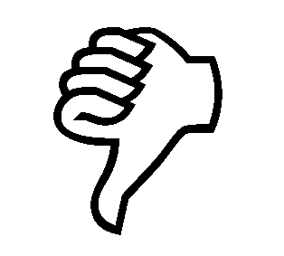

Positive or negative movie review?
unbelievably disappointing
Super awesome satire, and some great plot twists. Liked it!
Let me be clear Infinity War is not flawless, it has its faults but thankfully they are overshadowed by two hours of awesomeness.
Finally watched #Moana and thought it was good BUT not as good as everyone was hyping it up to be. She a cute bby though

Slide 4
Scherer Typology of Affective States
Emotion: brief organically synchronized … evaluation of a major event
angry, sad, joyful, fearful, ashamed, proud, elated
Mood: diffuse non-caused low-intensity long-duration change in subjective feeling
cheerful, gloomy, irritable, listless, depressed, buoyant
Interpersonal stances: affective stance toward another person in a specific interaction
friendly, flirtatious, distant, cold, warm, supportive, contemptuous
Attitudes: enduring, affectively colored beliefs, dispositions towards objects or persons
liking, loving, hating, valuing, desiring
Personality traits: stable personality dispositions and typical behavior tendencies
nervous, anxious, reckless, morose, hostile, jealous
Emotion: brief organically synchronized … evaluation of a major event
angry, sad, joyful, fearful, ashamed, proud, elated
Mood: diffuse non-caused low-intensity long-duration change in subjective feeling
cheerful, gloomy, irritable, listless, depressed, buoyant
Interpersonal stances: affective stance toward another person in a specific interaction
friendly, flirtatious, distant, cold, warm, supportive, contemptuous
Attitudes: enduring, affectively colored beliefs, dispositions towards objects or persons
liking, loving, hating, valuing, desiring
Personality traits: stable personality dispositions and typical behavior tendencies
nervous, anxious, reckless, morose, hostile, jealous

Slide 5
Sentiment Analysis
Is the attitude of this text positive or negative?
Rank the movies based on the reviews from 1 to 10
Future Scope - Detect the target, source, or complex attitude types
Is the attitude of this text positive or negative?
Rank the movies based on the reviews from 1 to 10
Future Scope - Detect the target, source, or complex attitude types

Slide 6
Sentiment Analysis: Steps
Movie Review Dataset : Identification
Train Data : Tokenization
Test Data: Core processing
Classification

Slide 7
Sentiment Analysis: Steps
Movie Review Dataset : Identification
The dataset is comprised of 400 positive and 400 negative movie reviews drawn from an archive of the arts, movies, reviews newsgroup hosted at IMDB.
The dataset is called as “polarity dataset“.
Training Data: http://ai.stanford.edu/~amaas/data/sentiment/

Slide 8
Sentiment Analysis: Steps
Train Data: Tokenization
Form vocabulary for each unique word in trained dataset
Form (docid,termfreq) pair in Positive & Negative dataset so that our search is easier
Store the data into local directory

Slide 9
Sentiment Analysis: Steps
Test Data: Pre-processing
Only English words are considered.
All text has been converted to lowercase to ease the comparison.
White space around punctuation like periods, commas, and brackets is pruned.

Slide 10
Sentiment Analysis: Steps
Test Data: Core processing
Split into Tokens
Remove punctuation from encircling words (e.g. ‘Bravo!, (and)’).
We have used stop words elimination technique learned from homeworks:
Remove tokens that have one character (e.g. ‘a’).
Removing jargons specific to movie like(e.g. ‘movie’, ‘reviews’, ‘names’- person, movie )
Remove tokens that don’t have any impact on sentiment(e.g. ‘and’, ‘the’)

Slide 11
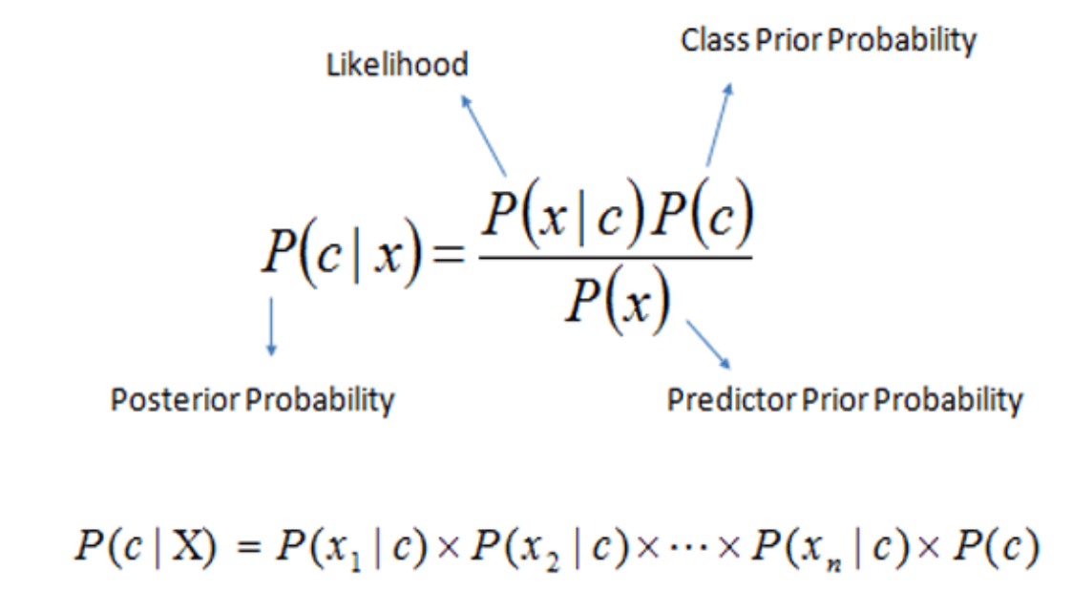
Sentiment Analysis: Steps
Classification : Naïve Bayes
The Naïve Bayes model involves a simplifying conditional independence assumption. That is given a class (positive or negative), the words are conditionally independent of each other.
In our case, the maximum likelihood probability of a word belonging to a particular class is given by the expression:
P(Positive | Love) = P( Love | Positive) * P(Positive) / P (Love)
Here we have
P (Love |Positive) = 3/9 = 0.33,
P(Love) = 5/14 = 0.36,
P( Positive)= 9/14 = 0.64
Now, P (Positive | Love) = 0.33 * 0.64 / 0.36 = 0.60, which has higher probability.

Slide 12
Sentiment Analysis: Additional Steps
Negation Handling : Negation handling was one of the factors that contributed significantly to the accuracy of our classifier.
Since we are using each word as feature, the word “good” in the phrase “not good” will be contributing to negative sentiment rather that positive sentiment as the presence of “not” will change the sentiment of the word.

Slide 13
Training Phase

Slide 14
Artifacts:
-800 trained data
-400 positive data
-400 negative data
-10825 words
-20 movies
-206 reviews
-No Toolkit
-Naïve Bayes algorithm using Java
-94 -96% Accuracy Rate

Slide 15
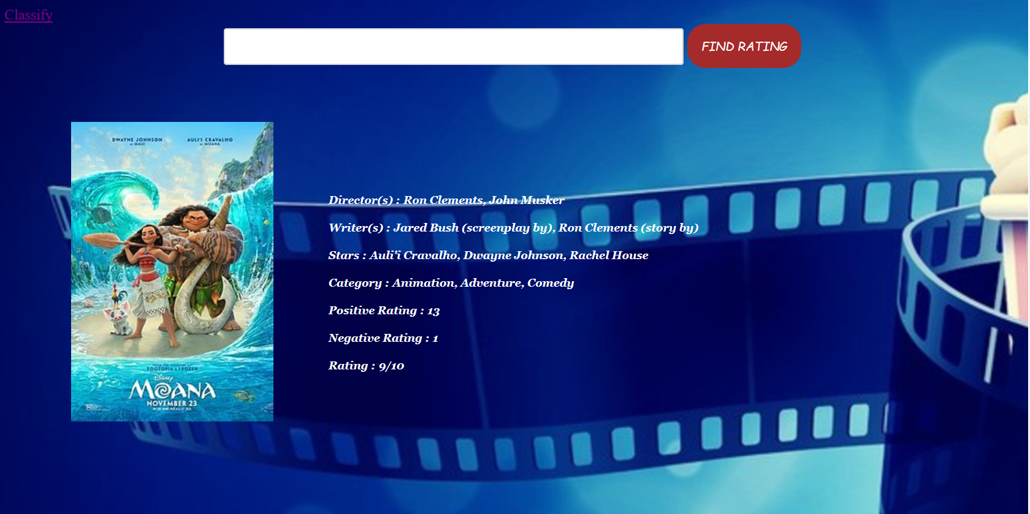
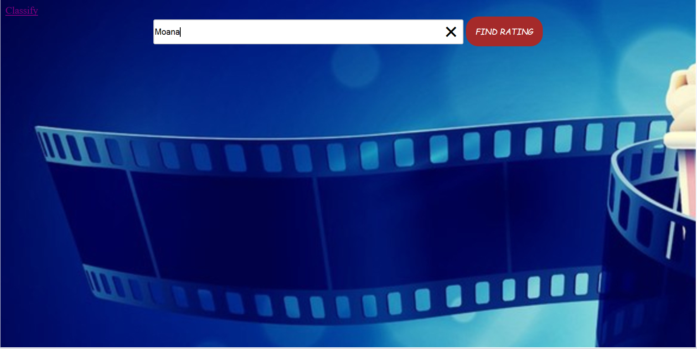
Implementation: Website

Slide 16
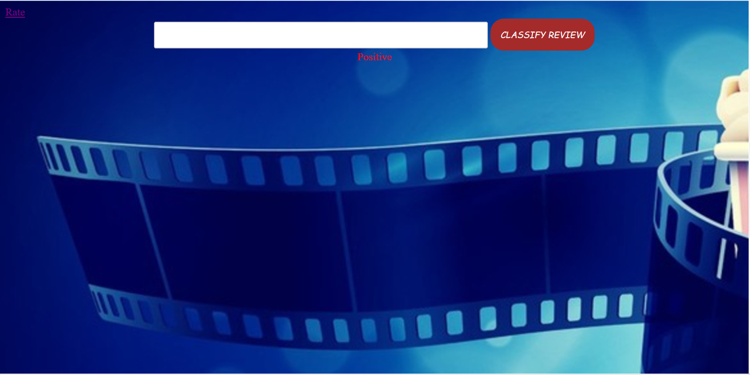
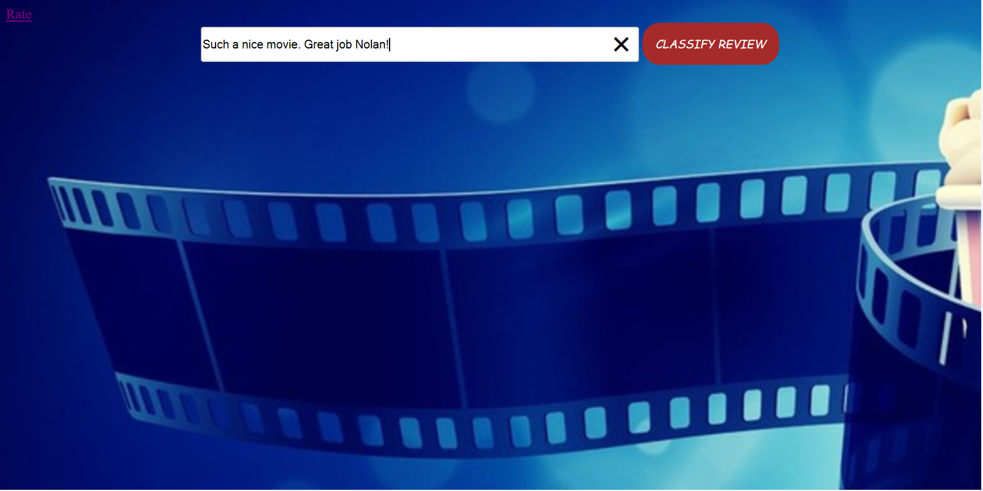
Implementation: Website

Slide 17
Future Scope:
Implement Interface to Collect Training Data.
Give Automatic Recommendation to user based upon personalized choice.
Collect the live data from twitter using Twitter APIs for making the application robust.
Improve the Processing Speed
Improve accuracy rate

Slide 18
Credits:
Dr. Alexander Kotov
Published Paper: https://arxiv.org/ftp/arxiv/papers/1305/1305.6143.pdf
Public resource:
www.public.asu.edu/~huanliu/dmml_presentation/2008/Sentiment+Analysis.ppt
analyticsvidhya.com
dataquest.io
IMDb
Twitter
Wikipedia

Slide 19
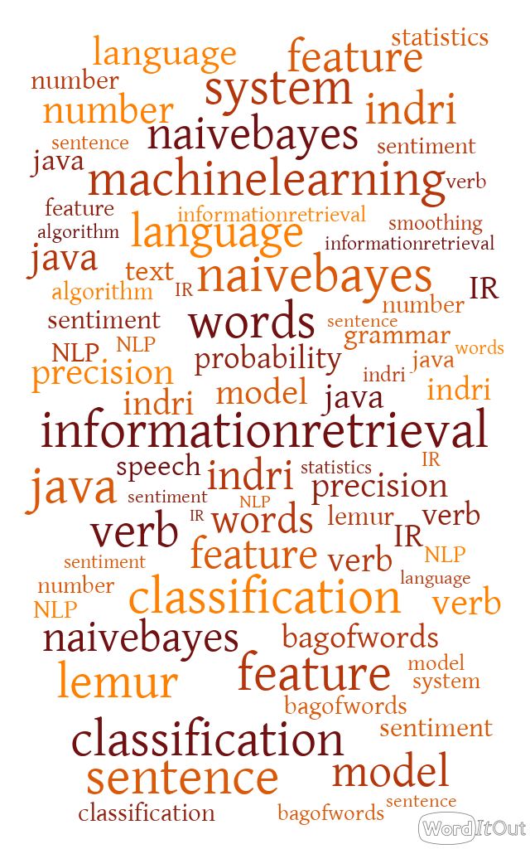

Thank You

